Slide 1

Computer Engineering Department A.P. Shah Institute of Technology G.B.Road,Kasarvadavli, Thane(W), Mumbai-400615 UNIVERSITY OF MUMBAI Academic Year 2021-2022

Slide 2

Synopsis on Pocket IDE Submitted in partial fulfillment of the degree of Bachelor of Engineering(Sem-3) in Computer Engineering By Saurabh Purushottam Bhoir(20102076) Akshaykumar Fatechand Jain(20102093) Sahil Sandeep Chordia(20102094)
Noor Bano Abrar Ahmed Ghoshi(20102160)
Under the Guidance of Jaya Gupta

Slide 3
Abstract
There are many IDE(Integrated Development Environments) available on the Play Store for writing programs in Android OS, but most of them are quite difficult to use and they are no quite user friendly. Especially beginners find them very difficult to use.
To overcome these problems, we are preparing a user friendly, easy to use and most of all a reliable application where users can write and run programs in programming languages like C, C++ and Java.
This application will be like a portable IDE where users can write, edit and run programs in their palms.

Slide 4
1.1 Problem Definition
In this project the aim is to build a user friendly IDE with easy to use features for android OS, resulting in better understanding for all.

Slide 5
1.2 Objectives
To make it easy to use for learners.
To enables students and learners to consolidate the different aspects of writing a computer program.
To make it reliable and comfortable for the user.

Slide 6
1.3 Scope
There are many IDEs available but they are difficult to use and run.
We decided to make this IDE user friendly so people especially students can write, edit, run programs easily in C, C++ and java languages.
Beginners will find it very easy to perform programming tasks as all the progress will be autosaved.
It will also highlight keywords, Constructors, ets for ease of programming.

Slide 7
1.4 Existing System/project
There are many applications available to download to write and run programs in various languages.
Applications available for C/C++ :
TurboCdroid
C4droid
CppDroid
Applications available for Java :
Java N-IDE
Jedona

Slide 8
2. Technology stack
Android Studio : It is a popular IDE designed specifically for android development.
Jdoodle Compiler API: This online API sends data that compile the code passed to it and gives the output in the form of string.
Java : Java is a high-level, class-based, object-oriented programming language that is designed to have as few implementation dependencies as possible.
XML : Extensible Markup Language is a markup language that defines a set of rules for encoding documents in a format that is both human-readable and machine-readable.

Slide 9
3.1 Benefits for Society
It will provide the ability to write edit and run programs in the palms of the users through their Android device.
Students and learners will find it very useful as they can complete their practical work and project work easily while travelling.
Helps to those people who wants to write codes but does not have a desktop or laptop .

Slide 10
3.2 Applications
Allows users to write code on the fly anytime, anywhere without a desktop or laptop
Students can complete their academic work and coding related submissions from anywhere without the need of having a computer.
Learners can practice their coding skills in their free time even if they don’t have a laptop but have a smartphone.

Slide 11
4.1 Project Design
All the projects of user are saved in the external storage device.
Text Editor :
It highlights the keyword
shows numbering for each line
smartly makes constructor, function or class
Jdoodle Compiler API is used in the project to compile C, C++ and java programs
Friendly User Interface – The Program writing, and execution goes hand in hand

Slide 12
4.2 Project Implementation
File Saver Activity
Step 1. There Tab View namely C, C++ and Java.
Step 2. There is a FAB(Add Button) which on clicking opens a dialog box.
Step 3. The dialog box takes the input for filename and the language.
Step 4. If filename is not Empty and the user has selected a language then on
clicking save a file is created and user is directed to the Editor Page(MainAcivity).
Step 5. Later the user can also select the same file from the tab view to edit it further.

Slide 13
4.2 Project Implementation
Main Activity
Step 1. The Main activity page is divided into 3 parts with the Code Editor at top, Action Button in middle and Output screen in the bottom.
Step 2. There is a number adapter in the Editor part which counts the number of lines used and displays them at the left side of every line.
Step 3. The Clear Screen button is used to clear the output screen.
Step 4. The Compile Button first saves the code in the file and then sends it to the compiler to compile and run it.

Slide 14
4.2 Project Implementation
Main Activity
Step 1. For compiling, the code in the editor is first converted to a continuous String and saved as input string.
Step 2. Then the input string along with the ClientID, Client Secret ID and the URL of the Jdoodle API is passed to the server.
Step 3. After compiling the Output string coming from the API server is saved ytn the output String.
Step 4. Now the output string is displayed in the Output screen as the output. It also contains errors made in the program if any.

Slide 15
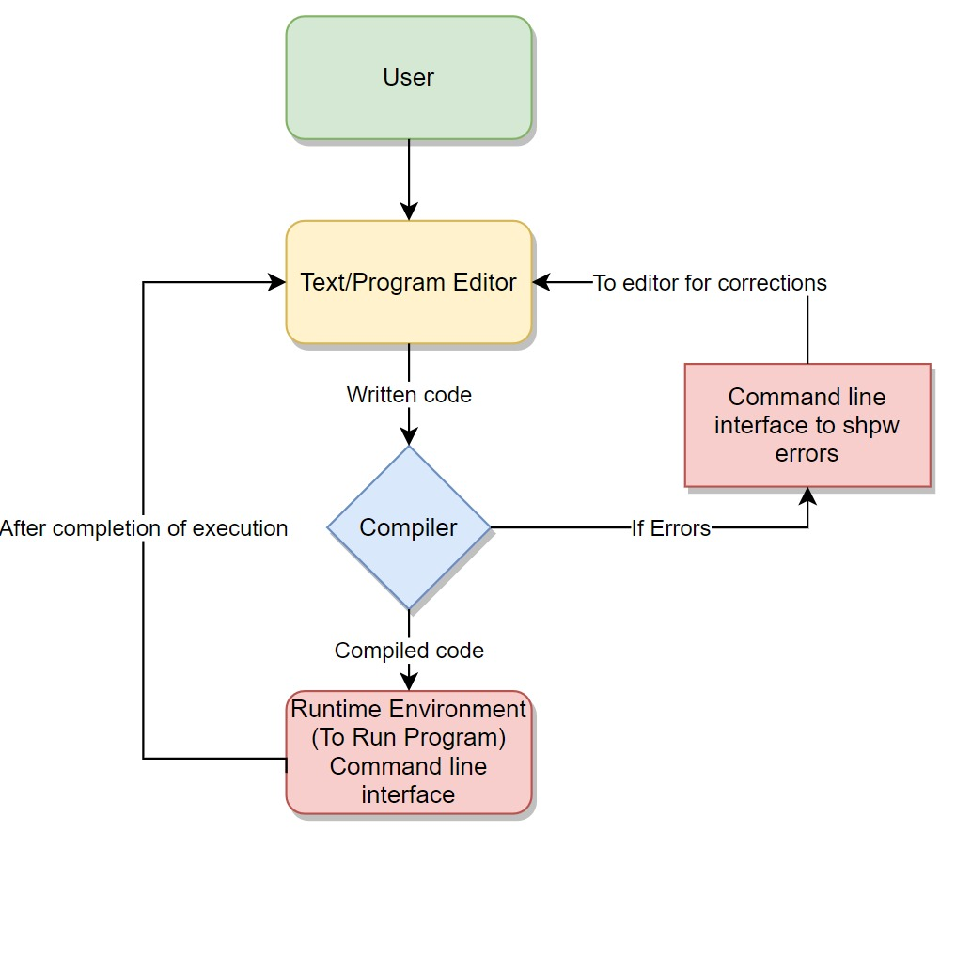
4.3 Module Flow Diagram

Slide 16
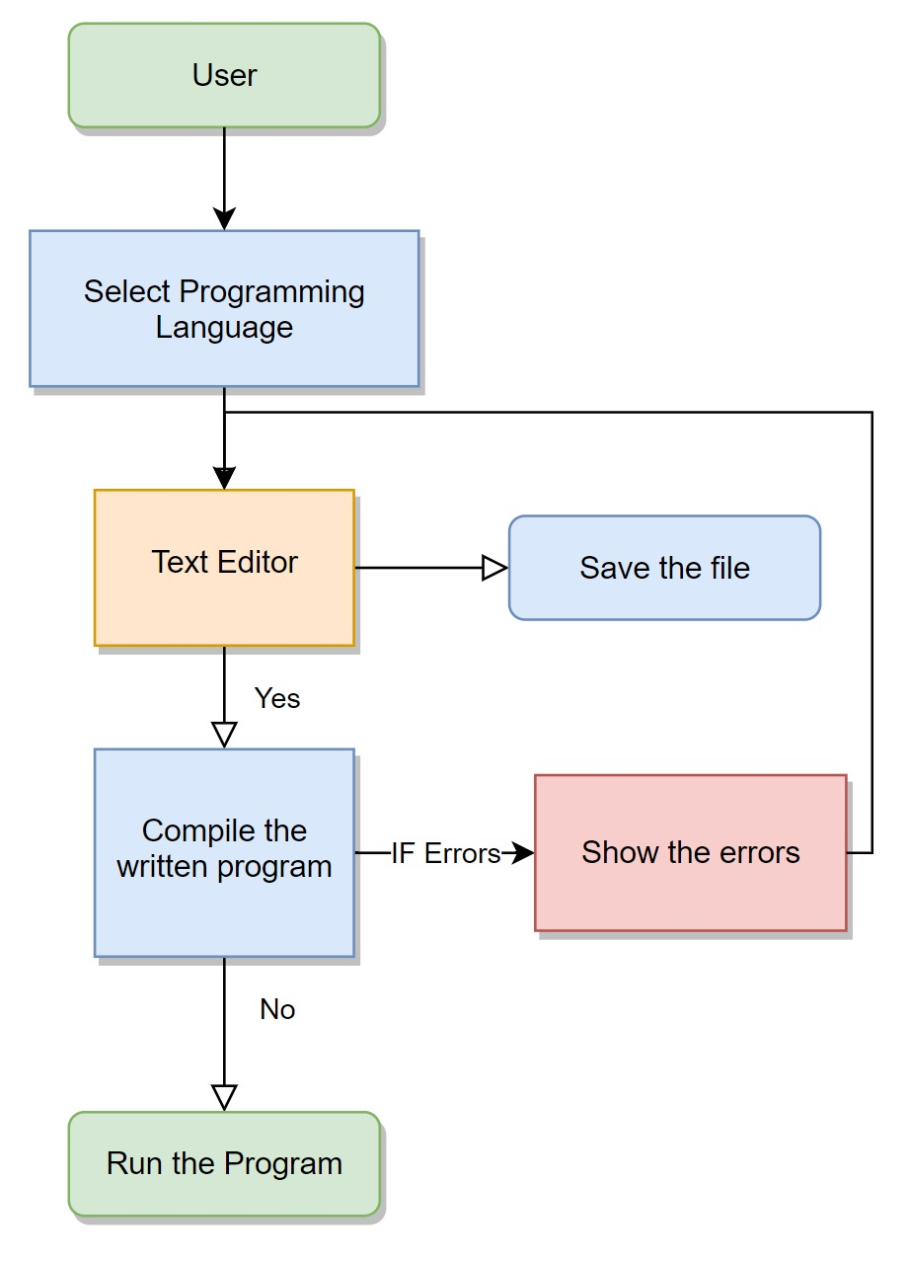
4.4 Use Case Diagram

Slide 17
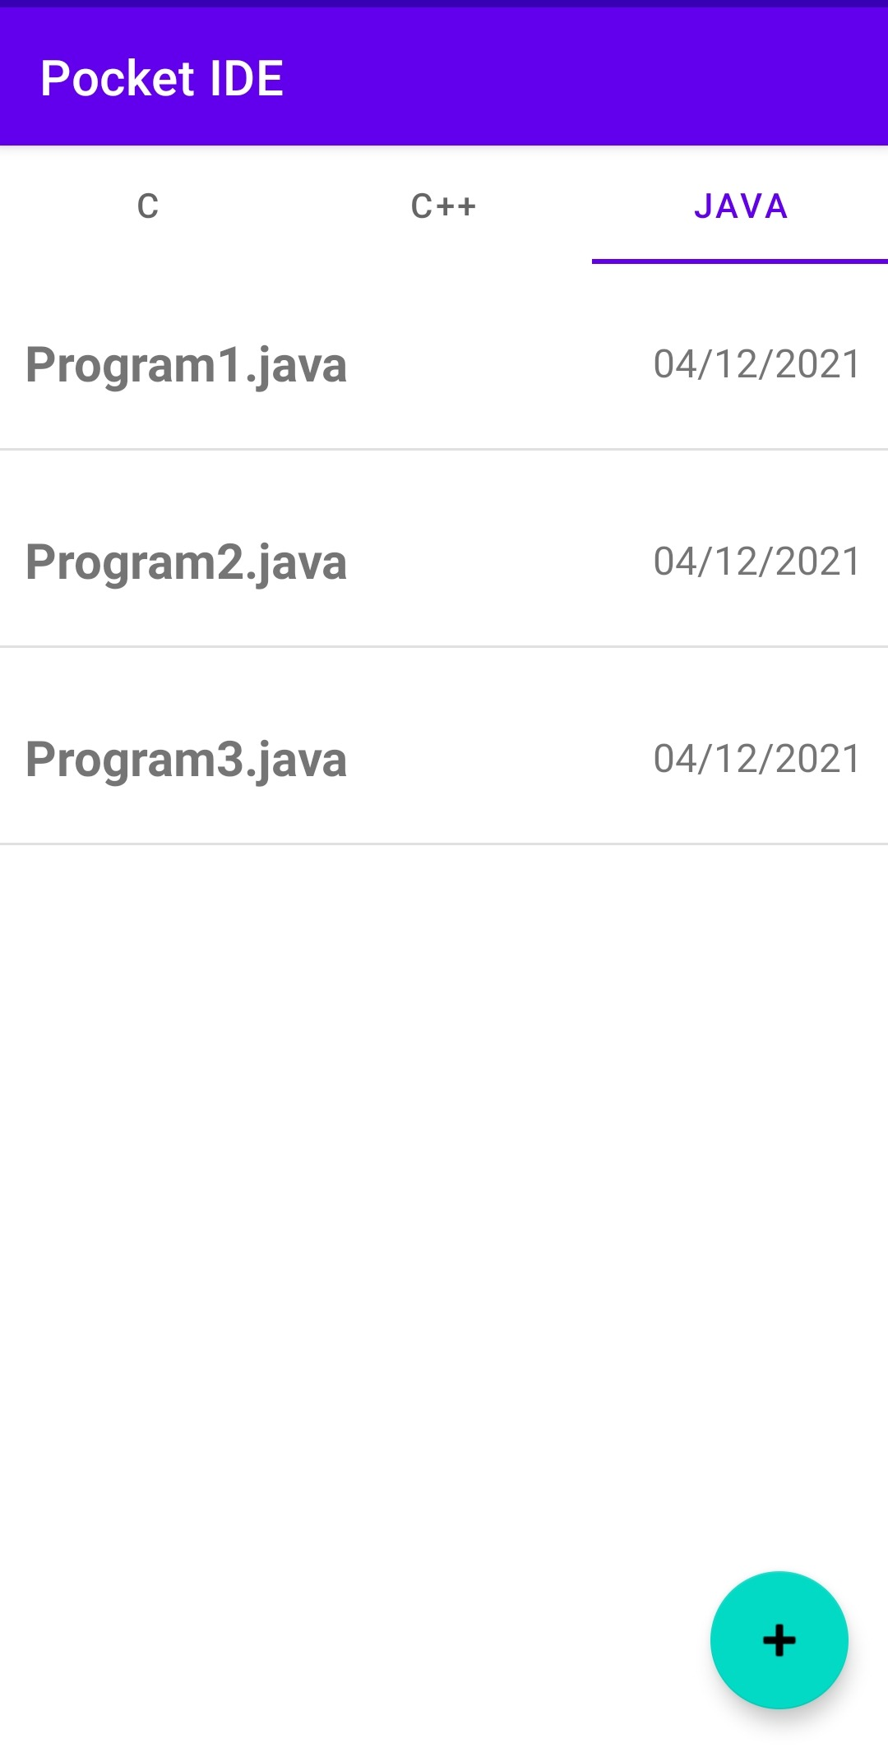
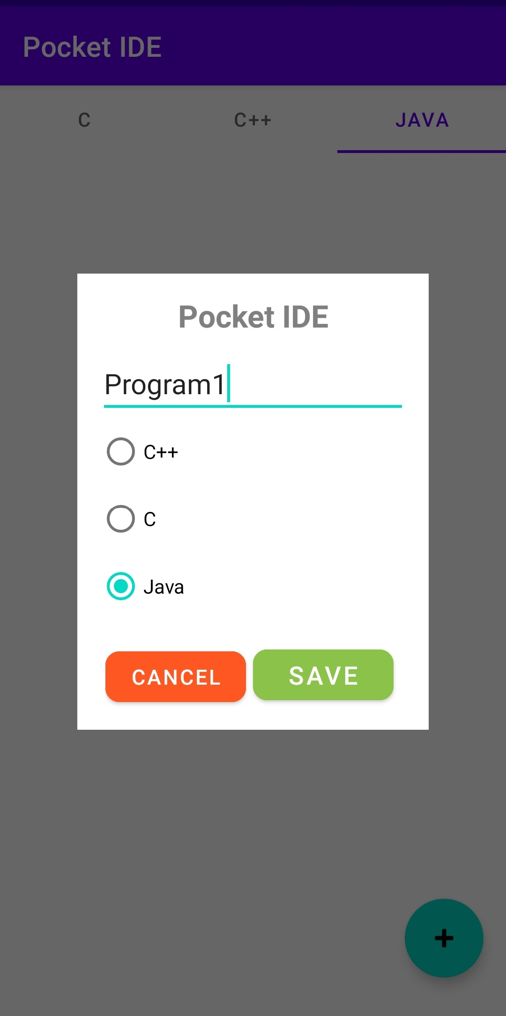
5 Result/Snapshots

Slide 18
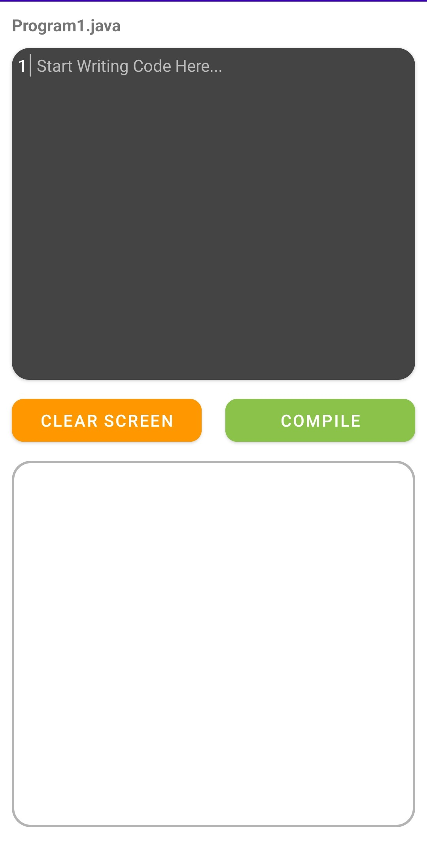
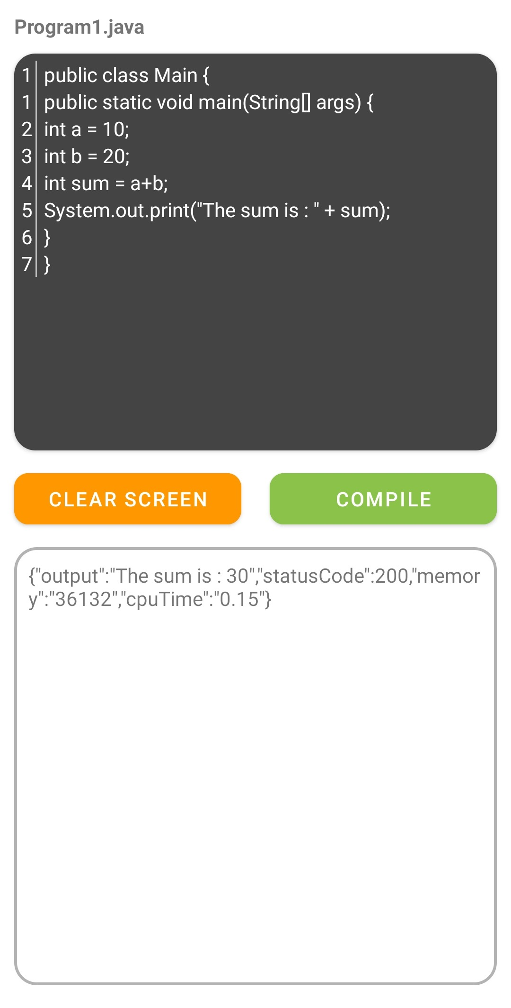
5 Result/Snapshots

Slide 19
6 Bibliography
Jdoodle API Documentation:
Helped us to implement the Jdoodle API in our program.
Link: https://docs.jdoodle.com/compiler-api/compiler-api
Stack Overflow forum;
Helped us to solve code related problems in the project.
Link: https://stackoverflow.com/

Slide 20

Thank You

